Slide 1
Support Vector Machine (SVM)

Slide 2
Introduction
A Support Vector Machine is a supervised algorithm that can classify cases by finding a separator.
SVM works by first, mapping data to a high-dimensional feature space so that data points can be categorized, even when the data are not otherwise linearly separable.
Then, a separator is estimated for the data.
The data should be transformed in such a way that a separator could be drawn as a hyperplane.

Slide 3
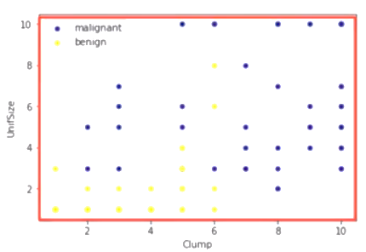
For example, consider the following figure, which shows the distribution of a small set of cells, only based on their Unit Size and Clump thickness.
It represents a linearly, non-separable, dataset.

Slide 4
The two categories can be separated with a curve, but not a line as in most real world datasets.

Slide 5
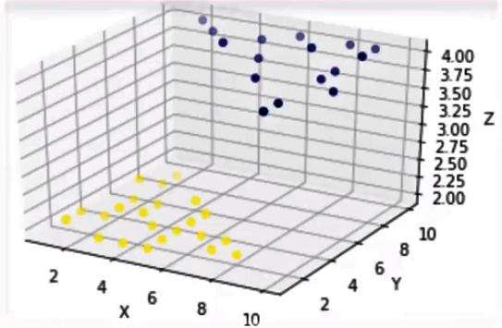
We can transfer this data to a higher dimensional space … for example, mapping it to a 3-dimensional space.

Slide 6
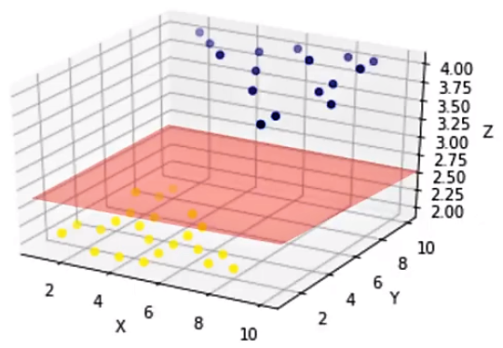
After the transformation, the boundary between the two categories can be defined by a hyperplane.
As we are now in 3-dimensional space, the separator is shown as a plane.
This plane can be used to classify new or unknown cases.

Slide 7
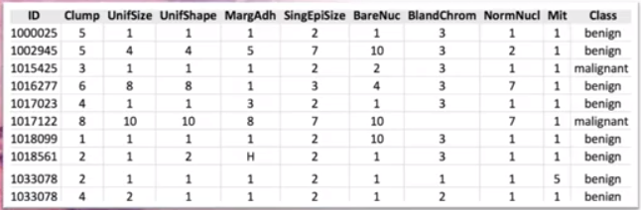
Analysis of the original data showed that many of the characteristics differed significantly between benign and malignant samples.
You can use the values of these cell characteristics in samples from other patients to give an early indication of whether a new sample might be benign or malignant.
?

Slide 8
Here, SVM can be used as a classifier, to train your model to understand patterns within the data to identify benign or malignant cells.
Once the model has been trained, it can be used to predict your new or unknown cell with rather high accuracy.

Slide 9
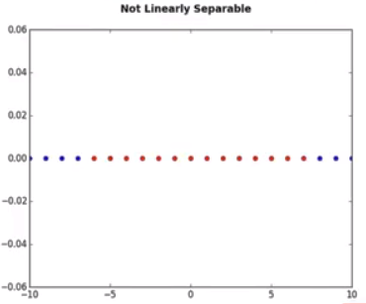
Data transformation
Imagine that our dataset is 1-dimensional data, this means, we have only one feature x.
It is clearly visible that it is not linearly separable.
So, what we can do here?
Well, we can transfer it into a 2-dimensional space.

Slide 10
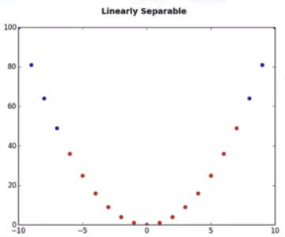
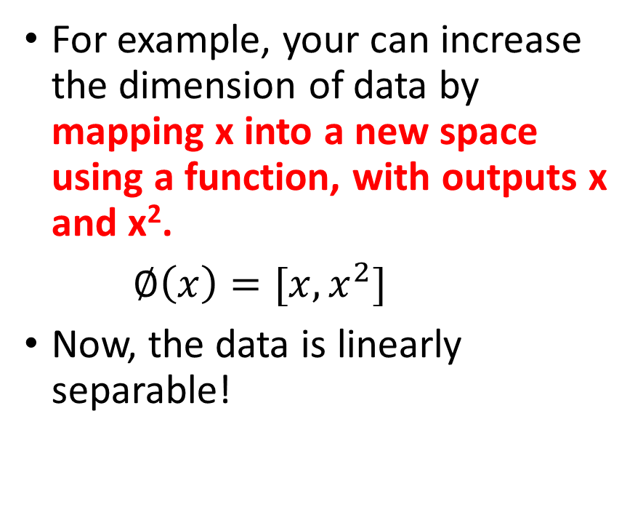
For example, your can increase the dimension of data by mapping x into a new space using a function, with outputs x and x².
$∅\left(x\right)=[x,x^{2}]$
Now, the data is linearly separable!
x²
x

Slide 11
Notice that, as we are in a two dimensional space, the hyperplane is a line dividing a plane into two parts where each class lays on either side.
Now we can use this line to classify new cases.
x²
x

Slide 12
Mapping data into a higher dimensional space is called kernelling.
The mathematical function used for the transformation is known as the kernel function, and can be of different types, such as:
Linear,
Polynomial,
Radial basis function (or RBF), and
Sigmoid.
Each of these functions has its own characteristics, its pros and cons, and its equation, but you don’t need to remember them as it is already implemented in form of machine learning libraries.
Since it is hard to estimate that which function performs best with any given dataset, we usually choose different functions in turn and compare the results.

Slide 13
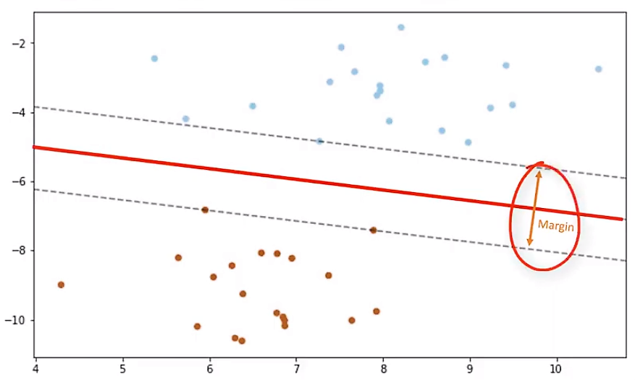
Finding optimized separator after transformation
One reasonable choice as the best hyperplane is the one that represents the largest separation, or margin, between the two classes.
So, the goal is to choose a hyperplane with as big a margin as possible.

Slide 14
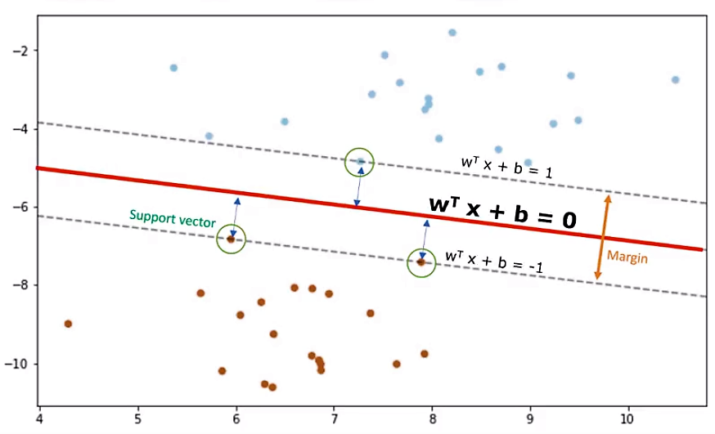
Only support vectors matter for achieving our goal; and thus, other training examples can be ignored.
We try to find the hyperplane in such a way that it has the maximum distance to support vectors, called optimal Hyperplane.
Hyperplane is learned from training data using an optimization procedure that maximizes the margin;
This optimization problem can be solved by Gradient descent.

Slide 15
The output of the algorithm is the values ‘w’ and ‘b’ for the line.
You can make classifications using this estimated line.
It is enough to plug in input values into the line equation, then, you can calculate whether an unknown point is above or below the line.
If the equation returns a value greater than 0, then the point belongs to the first class, which is above the line, and vice versa.

Slide 16
SVM Applications
Image Analysis such as image classification and digit recognition
Text mining
Detecting spam
Text categorization
Sentiment analysis
Gene Expression data classification

Slide 17
ML Hands-on Session
You are working as Medical Analyst and have been given datasets which consists of several hundred human cell sample records, each of which contains the values of a set of cell characteristics.
Your job is the analyse the using human cell records, and classify cells to whether the samples are benign or malignant for any new cancer patient.

Slide 18

Please contact
Foundation for Innovation and Collaborative
Education
mentor@fice.in
www.fice.in
Please contact
Foundation for Innovation and Collaborative
Education
info@fice.in
mentor@fice.in
Notes:
Here are the lessons we are going to learn today.

